Slide 1
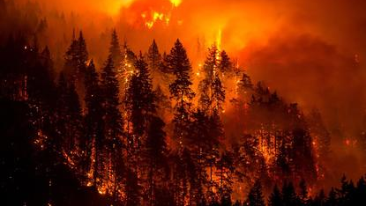
Population, Population Density and Active Fire Events Worldwide
Big Data Analysis in Extreme Environments Final Project
Tyler Bull, Spring 2021

Slide 2
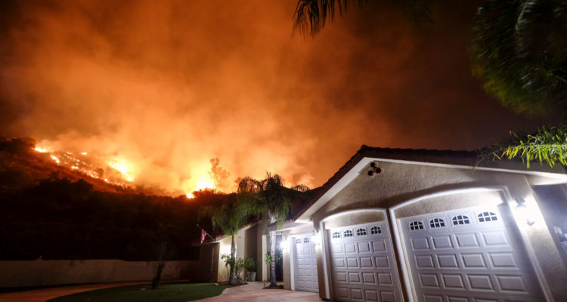
Proposal and Hypothesis
Proposed to look for relationships between:
Population Change, Population Density and Fire Instances Worldwide
Looking at discrete years 2003, 2005, 2010, 2015, 2019
Hypothesis:
A relationship will be found which shows a positive correlation between the population of a country, and the number of fires experienced in that country.

Slide 3
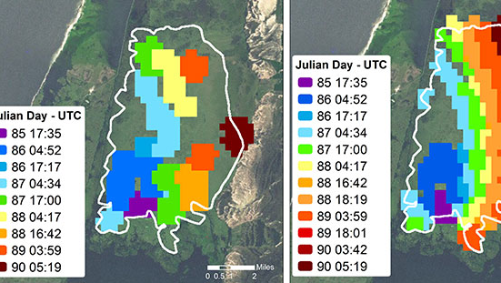
Data
Three datasets used for the analysis:
NASA Visible Infrared Radiometer Suite (VIIRS)
15,113,806 fires identified worldwide for all the years.
World Bank Population Data
195 Countries, data recorded for each year.
Landmass Dataset By Country
195 Countries.

Slide 4
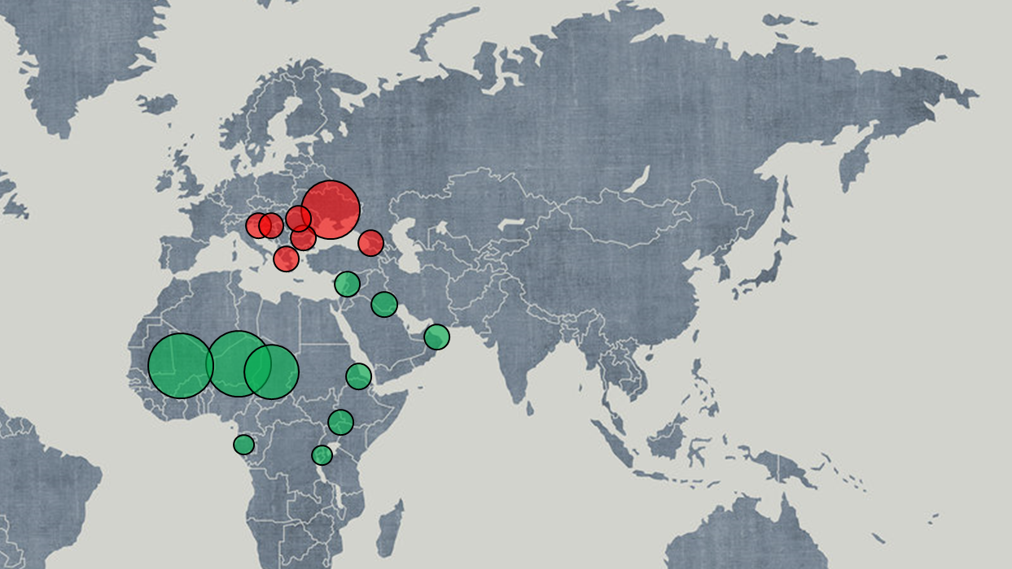
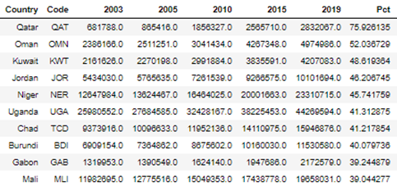
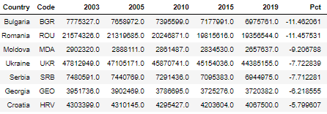
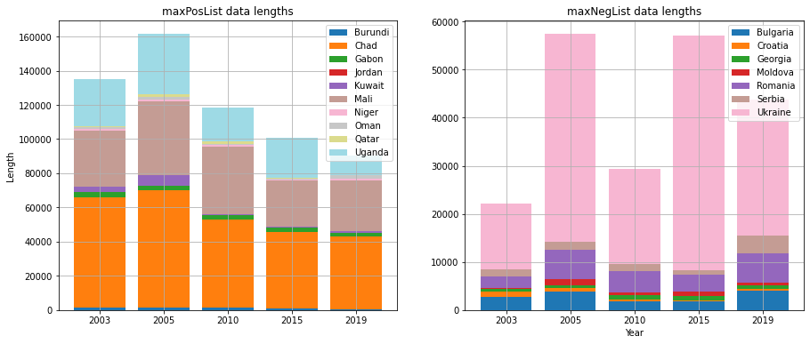
Population Gradient
Group A: 10 Big Growers
Group B: 7 Big Losers

Slide 5
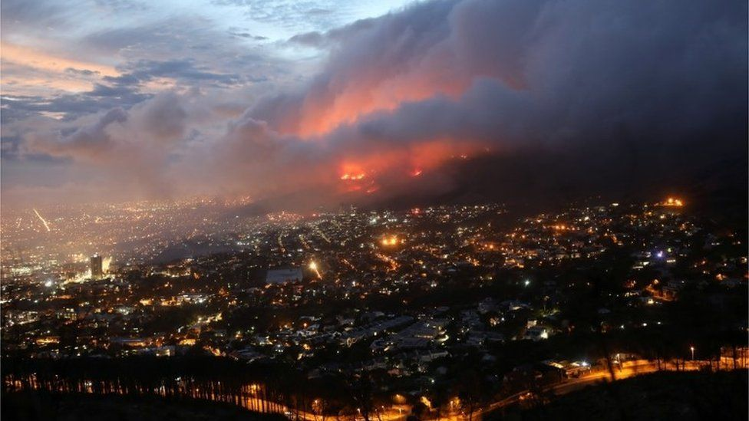
Fire Quantity vs. Population Change

Slide 6

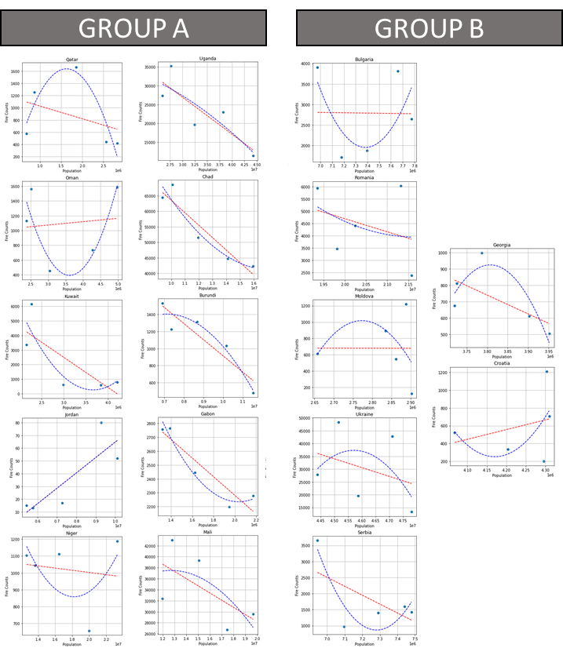
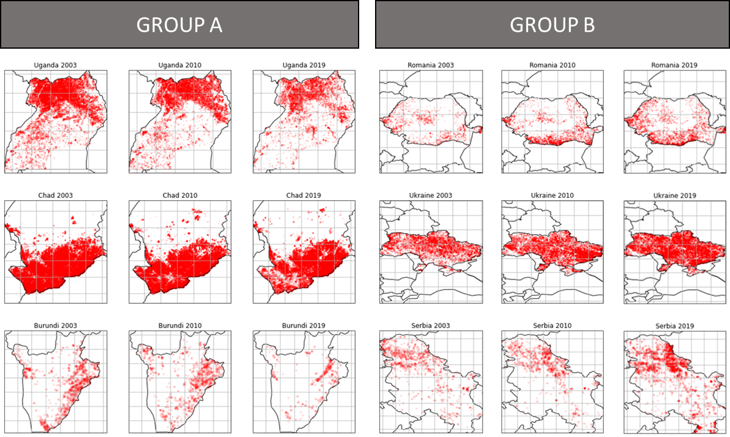
Results: Group A
Increase of population over data range.
Decrease in fire counts over data range (8/10)

Slide 7
Results: Group B
Increase of population over data range.
Increase in fire counts over data range (6/7)

Slide 8
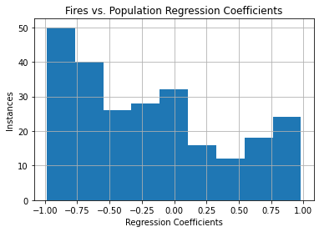
Results: World
Strong lead in strength (r) and quantity for negative correlation.

Slide 9
Fire Quantity vs. Population Density (worldwide)

Slide 10
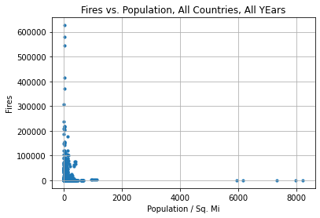
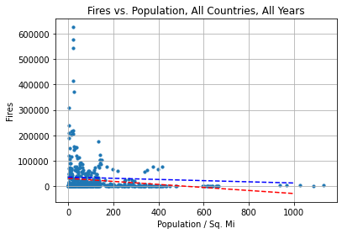
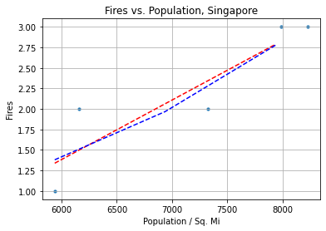
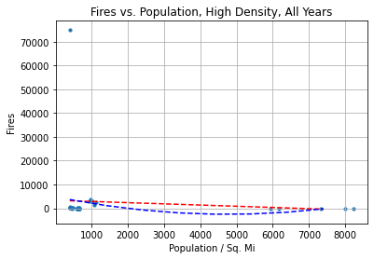
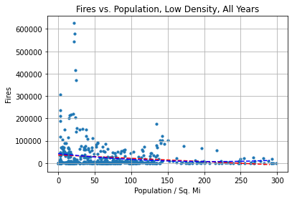

Slide 11
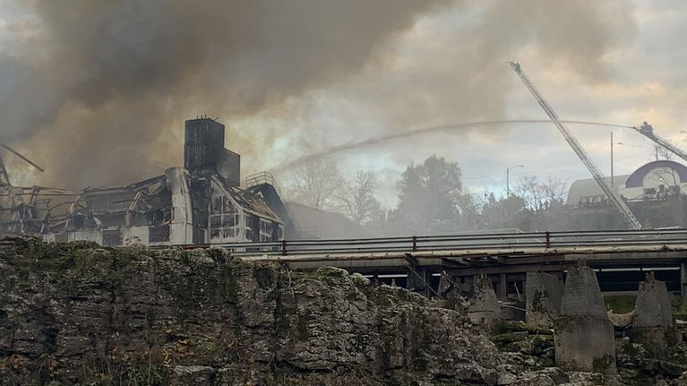
Conclusions
Correlation is clear
Population density and fire quantities are inversely related.
Population growth and decay are associated to inverse trends in fire quantities.
Causation is uncertain
Man stops fires?
Fire control, firefighters, increased cost and impact cause a response.
Fires stop man?
Dangerous areas dissuade residents and potential residents.

